Slide 1
Money Matters
Student Business Services
Orientation 2017

Slide 2
What does SBS do?
Collect on behalf of the University
Assess Tuition and Fees
Process Financial Aid and Refunds
Process Florida Prepaid and Third Party Billings
Provide yearly tax information

Slide 3
What might I be charged at FSU?
Tuition and Fees
Clinic Visits
Late Fees
Health Insurance
Meal Plans
International Programs
Parking Citations
Bookstore
Lost/Damaged Materials
Library Fines
Transcripts
Housing / Rent

Slide 4
Tuition Assessment / Rates
Current In-State Undergraduate Rate
$215.55 Per credit
Current Out-of-State Undergraduate Rate
$721.10 Per credit
Tuition is typically assessed one month out from the start of a term
Tuition is due by the end of the second week of the semester
Tuition is assessed per credit hour, not per course

Slide 5
Invoicing
FSU does not mail paper invoices until you have separated from the University
Students receive an email each Saturday morning to their campus email address notifying them of a balance
Online account statements are available 24/7 on MyFSU
We recommend that you check your account once per week

Slide 6
Consequences of Paying Late
Tuition:
    $100 Late Payment Fee
    Cancellation of class schedule
Parking / Housing:
    Late Fees
Balance > $500
    Holds on registration, transcripts, and diplomas
Balance < $500
    Holds on transcripts and diplomas

Slide 7
Payment Options
Financial Aid
  Disbursements occur prior to the start of term, at the start of term, and each Tuesday and Thursday following
Online
  Credit Card & eCheck
  2% service fee added to all credit card transactions
In Person
  Monday – Friday 8:30am – 4:30pm
  Cash, Check, Money Order, Cashier’s Check, FSUCard
By Mail
  Check or money order payable to FSU

Slide 8
Alternative Payment Methods
Florida Prepaid
  No proof of prepaid necessary
  Check your benefits letter to determine your plan type
  If plan purchased prior to 2007, differential fee is waived
529 / Investment / Savings Plans
  Contact your plan provider for exact instructions
  Typically, plans require an invoice from the institution before funds are released
VA Benefits
  You will work with FSU’s Veteran’s Affairs office to certify your schedule and benefits
  SBS will process your payment and coordinate any payment issues

Slide 9
What do you need to do?
Sign the Student Financial Responsibility Agreement before you enroll
Provide us with bank account information for your refunds
Complete a “Title IV” authorization to allow your federal aid to pay for your charges
Delegate a user to speak to us on your behalf
Make sure that you check your address and telephone information annually in case we need to get in touch with you

Slide 10
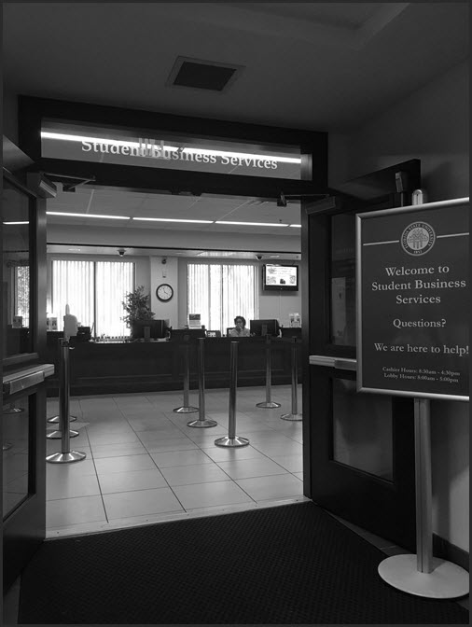
Our Contact Information
Mailing Address: Student Business Services
1500 University Center A
Tallahassee, FL 32306-2394
Telephone: (850)644-9452
Fax: (850)644-5142
Email: studentbusiness@fsu.edu

